Slide 1
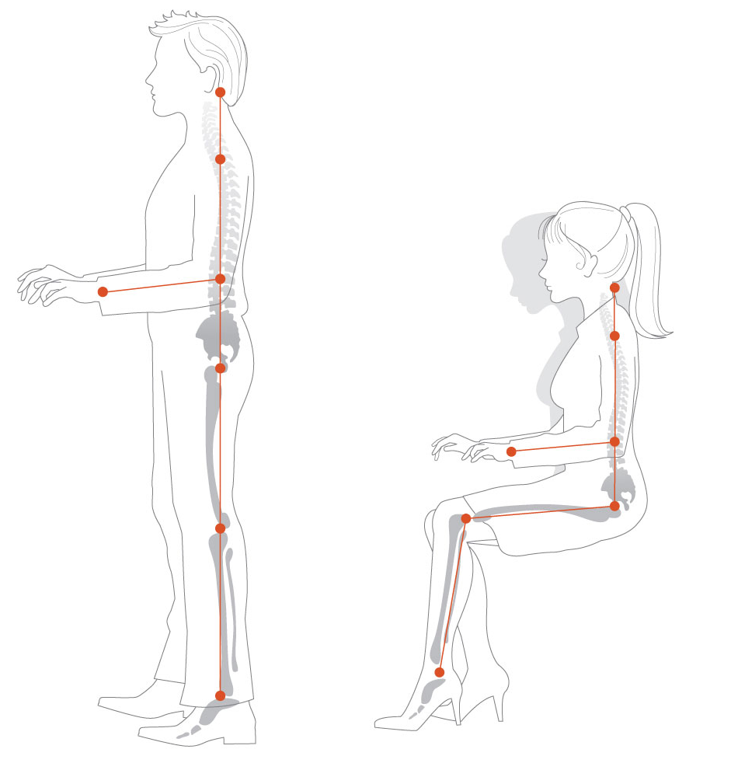
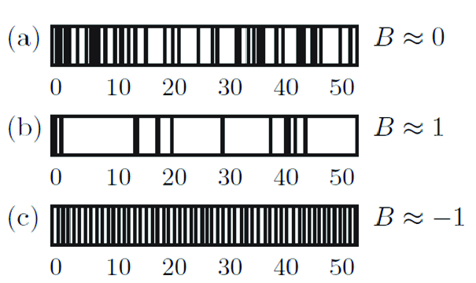
Sed-up and Burstiness
Mid point presentation
By
Archie Norman

Slide 2
SEDUP
Repair R code that labels a time series of accelerometer data according to two postures – upright or sitting/lying.
Package the code to prevent future issue.
The issue could stem from the fractionality of the frequency.
What's the most effective way to fix the issue.
BURSTINESS
Create R code to calculate the burstiness of a time-series of active and inactive events extracted from a body worn accelerometer.
Is there correlation between burstiness and health.
What's the most appropriate measure for burstiness.
Notes:
Talk about how it’s the code works fine when it's using a integer frequency but when there's a decimal it doesn’t work. This is likely due to the way matrixes are used in the code. Theres many ways to get round this 1 not using a matrix 2 round the freq 3 interpole 4 floor ceiling.
Mention how the files can only come in two different fractional freqs 66.7 and 85.7
if you’re sitting a lot you’re probably not as fit or if you switch between the two
Using the sedup code output I then have a list of the standing and sitting bouts with timestamps. This can then be used to calculate the burstiness of the data.

Slide 3
The Literature
paper | Key features | limitations
Measuring burstiness for finite event sequences (5) | Looking at inhomogeneous temporal patterns in natural and social phenomena. aims to improve the understanding, prediction, and control of complex systems. | its generalizability across different datasets and domains requires further validation. The models used assume periodic boundary conditions and specific interevent time distributions, which may not apply to all real-world data. Additionally, the study's localized model assumes a single burst, whereas many real-world datasets exhibit multiple bursts. While the new measure is demonstrated using a large-scale Twitter dataset, more diverse empirical validations are needed. The study also does not deeply explore other measures of temporal correlations or contextual bursts, and the sensitivity of the new measure to introduced parameters requires further investigation. Practical guidelines for implementing the new measure are not fully developed, and a comparative analysis with other existing measures would help clarify its advantages and limitations. These aspects highlight areas for future research to enhance the measure's robustness and applicability.
Burstiness and Memory in Complex Systems ∗(6) | Has a memory parameter (shows correlation between lengths of the busts being next to each other) | ∆ and µ offer only a first order approximation for the origin of the burstiness, and for a detailed comparison between models and real systems we need to inspect other measures as well, such as the functional form of P(τ). It also indicates the lack of proper modeling tools to capture the detailed mechanisms responsible for the bursty interevent time distributions seen in real systems, opening up possibilities for future work.
paper | method | participants | accuracy
Fast and Robust Algorithm for Detecting Body Posture Using Wrist-Worn Accelerometers (1) | logistic regression | 45 community-dwelling older adults | Left wrist - TP = 83%, TN = 91% Right wrist - TP = 86%, TN = 93%
Using Functional Principal Component Analysis to Quantify Sitting Patterns(2) | Functional Principal Component Analysis | 314 overweight postmenopausal women | 90% of the overall variation of activity counts was explained by two subject-level principal compo‑ nents (PC)
Deep Learning for Classifying Physical Activities from Accelerometer Data(3) | deep feed-forward neural network (DNN) and a deep recurrent neural network (RNN) | 24. participants | Accuracy: 84.89%, F1-score: 82.56%
method | Equation | Features or limitations
Coefficient of variation | CV = Sigma/mu (SD/mean) | Simple. Doesn’t consider temporal order and if mean is close to zero is can exaggerate variability
Burstiness Index | B = sigma – mu/sigma+mu (SD-mean/SD+mean) | Specifically designed for burstiness. Assumes data can be descried by mean and sd.
Inter-arrival Time Analysis | Var(X) = E[(X-mu)^2] Sigma = root of Var(X) | Directly analyses temporal data. Computationally intensive
Notes:
Memory isn’t really applicable in Melvyn's application but it’s a nice thought
Both of melyvns choices are warranted as sedup has been cited in a few papers praising it.
The burstiness measure is less of a set in stone procedure compared to the sedup code as its easy to change the formula but its still a solid choice

Slide 4
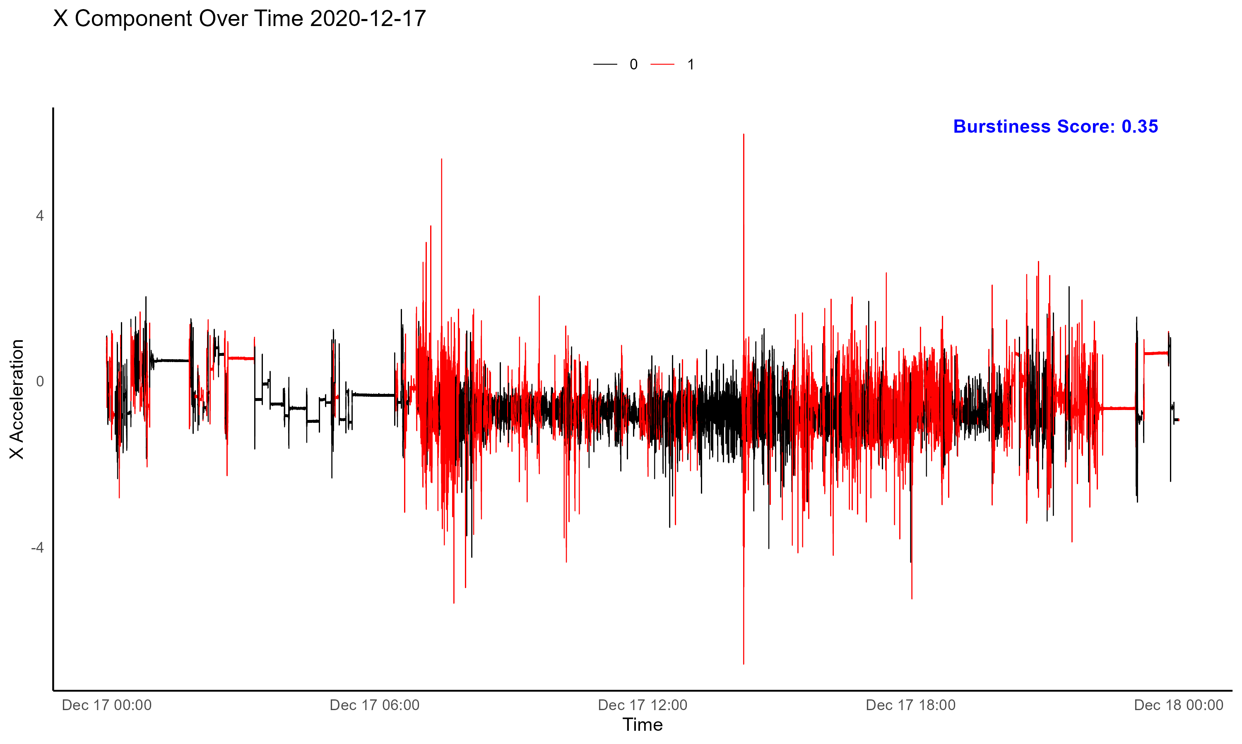
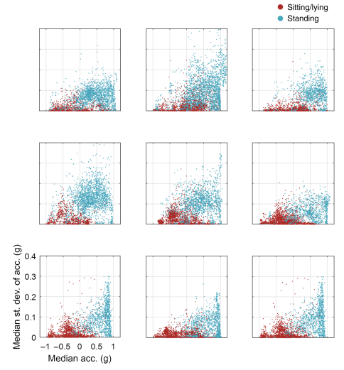
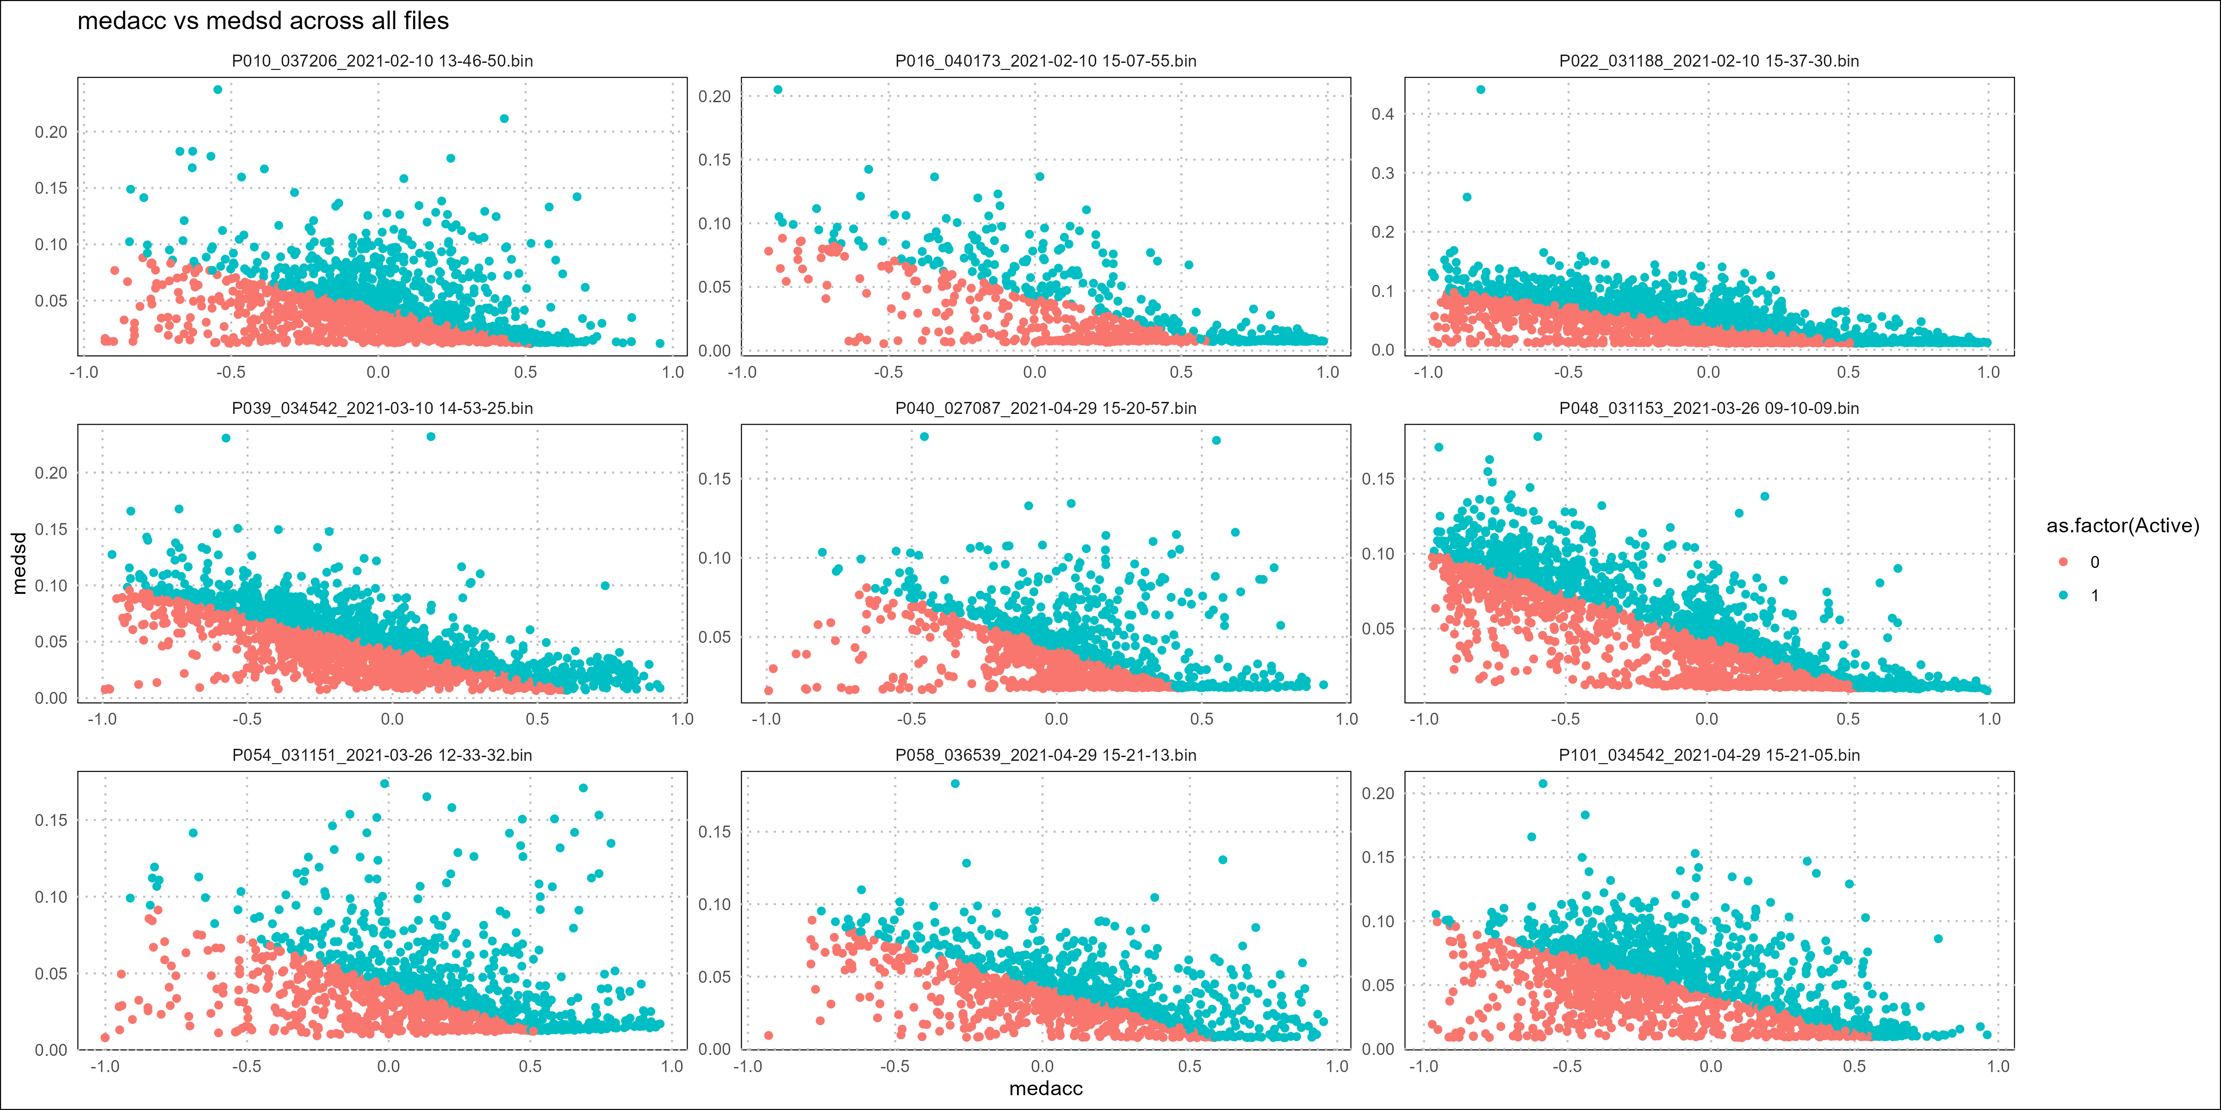
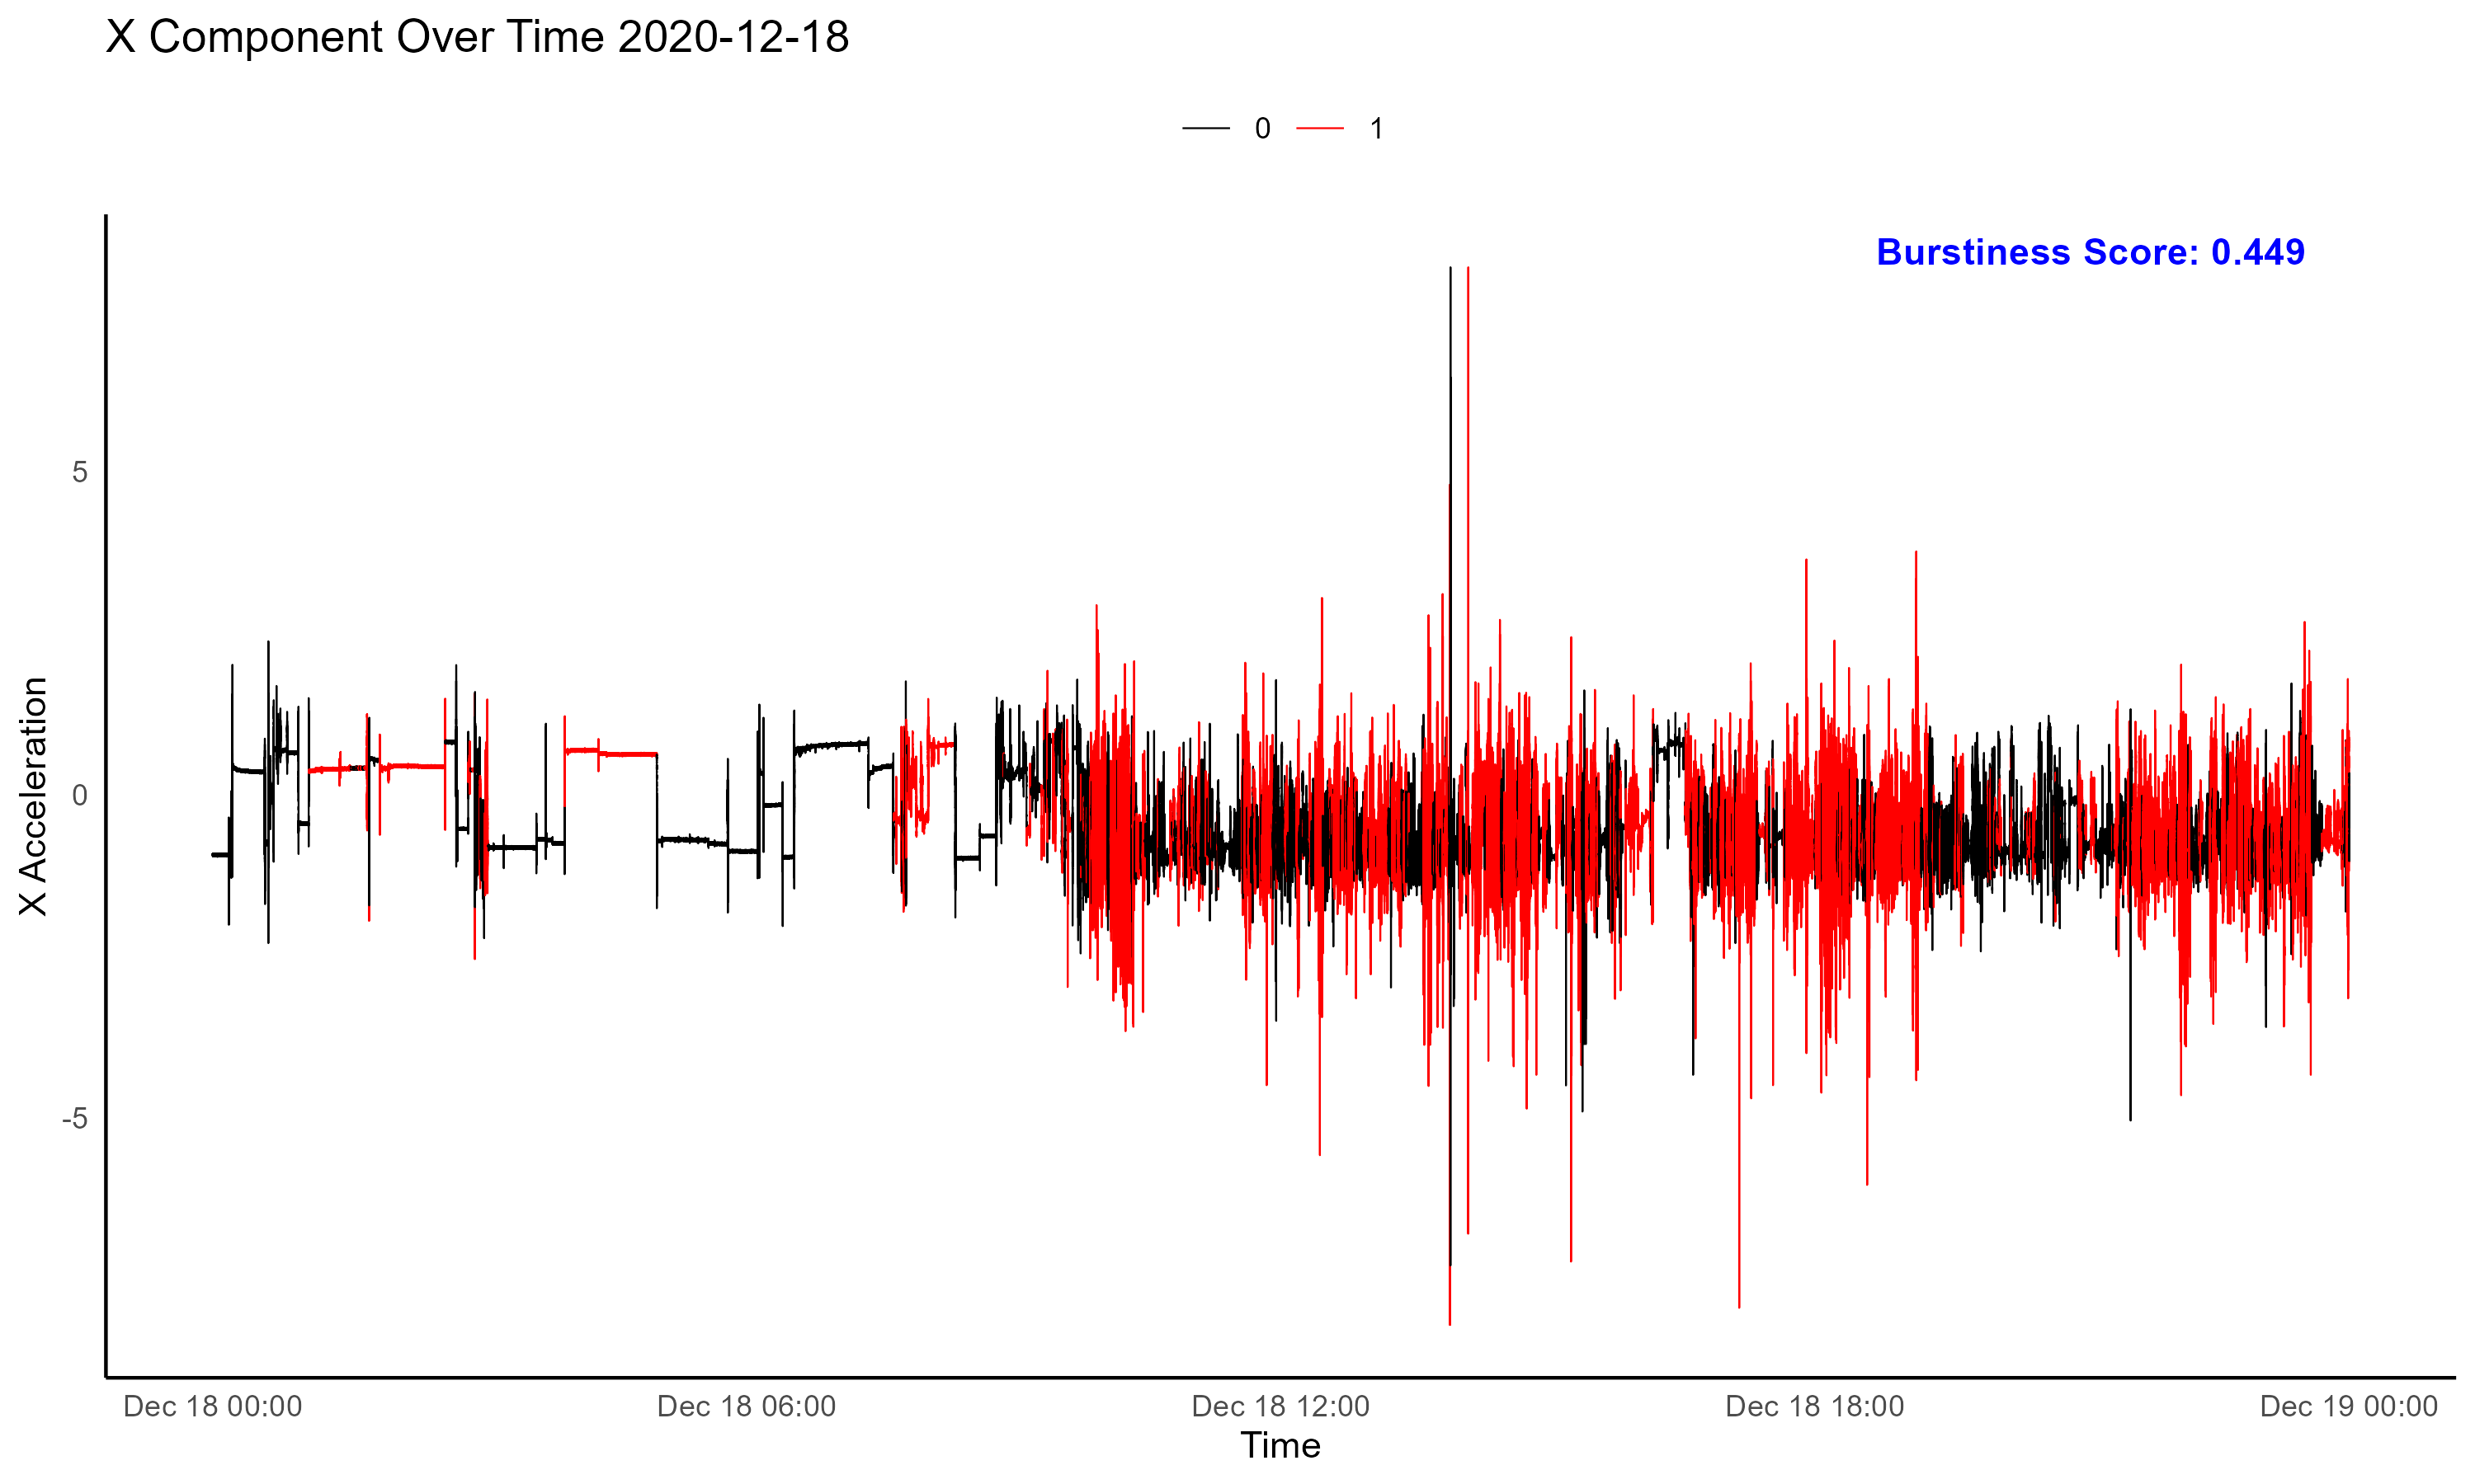
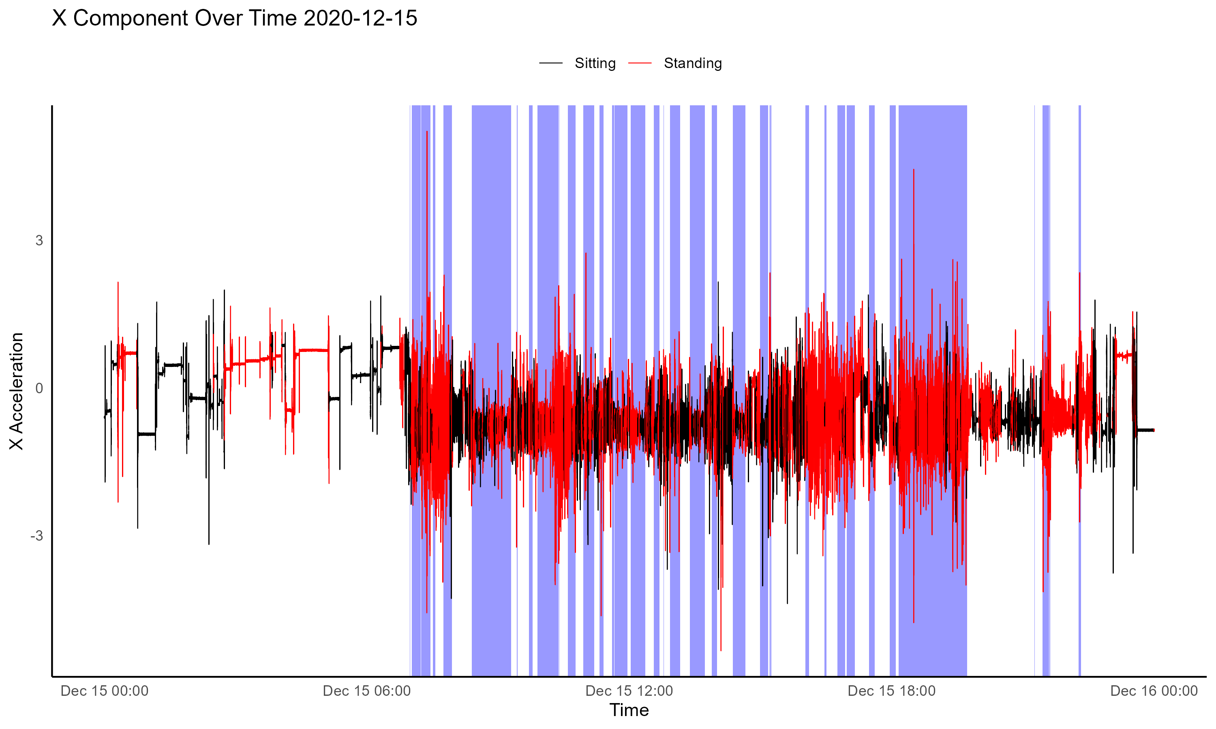
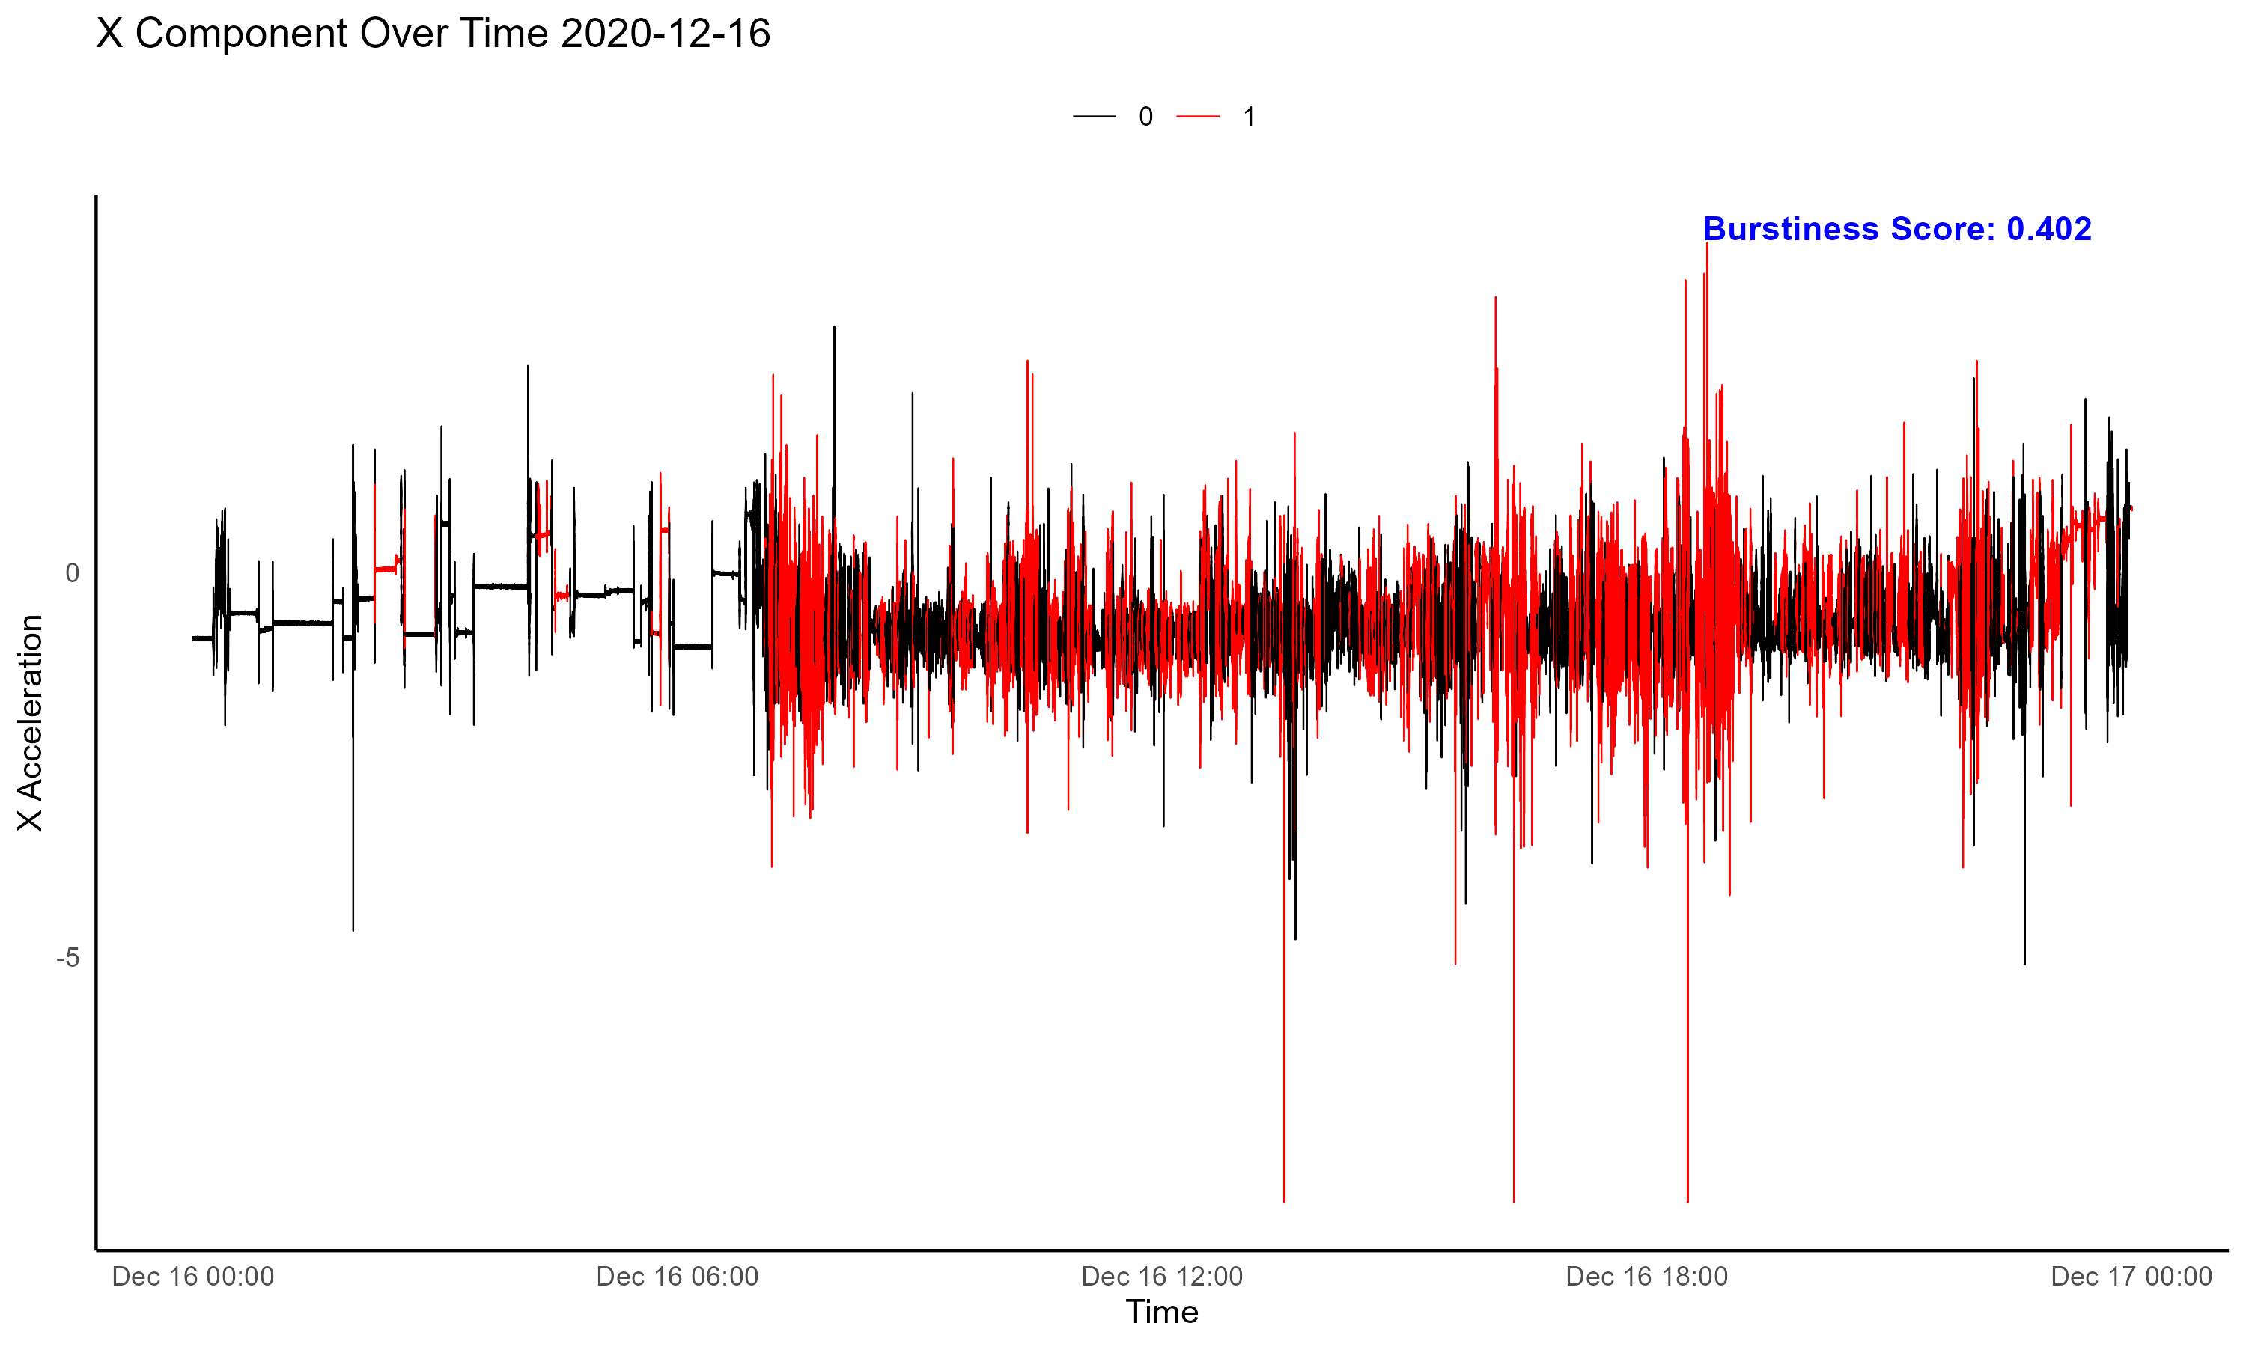
The data
Fig 1 and 2
Fig 4
Fig 3
Notes:
Talk about the device, how its collected, the data type, how the institions fo the device helped read the bin (binary file)
Fig 1 and 2
Comparssion of the logistic regrerssion boundaries between the sedup research and the given data
Fig 3
Red is sitting and standing from my data and blue is sitting and standing from the research
Figure 4
Just plots to show how a burstiness score would be implemented and how it could be useful
Also mention the problem with sleep

Slide 5
Bibliography
1- https://journals.humankinetics.com/view/journals/jmpb/3/4/article-p285.xml
2- https://ijbnpa.biomedcentral.com/articles/10.1186/s12966-024-01585-8
3- https://www.ncbi.nlm.nih.gov/pmc/articles/PMC8402311/
4-
5- https://arxiv.org/pdf/1604.01125
6- https://arxiv.org/pdf/physics/0610233
7 - https://www.cs.cornell.edu/home/kleinber/bhs.pdf

